Slide 1

AI IN CYBER – PHYSICAL
SYSTEM (CPS) SECURITY
“A Machine Learning-Based Intrusion Detection Approach”
Presented By:
Sunny Shukla
Sneha Pandey
Aditi Jaiswar
Digisuraksha Parhari Foundation May 12 , 2025

Slide 2

AI in Cyber-Physical Systems: Smarter, Safer, & More Secure
Cyber-Physical Systems (CPS) merge digital technologies with physical processes, creating integrated ecosystems that intelligently interact with the real world. With the rise of AI, CPS have become smarter, enabling enhanced automation, efficiency, and responsiveness.
However, as these systems grow in complexity, they pose significant security and safety challenges. Leveraging artificial intelligence is essential to improving protection mechanisms, making CPS more resilient against ever-evolving cyber threats.

Slide 3
What Are Cyber-Physical Systems (CPS) and Why Are They Vulnerable?
Cyber-Physical Systems are integrations of computation, networking, and physical processes. Examples include smart grids, autonomous vehicles, industrial automation, and medical monitoring systems.
In smart grids, for example, attacks on the communication network can lead to power outages, physical damage, or even safety hazards.
Ensuring these systems operate securely and reliably is critical given their importance to infrastructure and public safety.
Their vulnerabilities stem from interconnected components exposed to both digital attacks and physical faults. The blending of cyber and physical domains creates complex attack surfaces that traditional IT security cannot fully address.

Slide 4
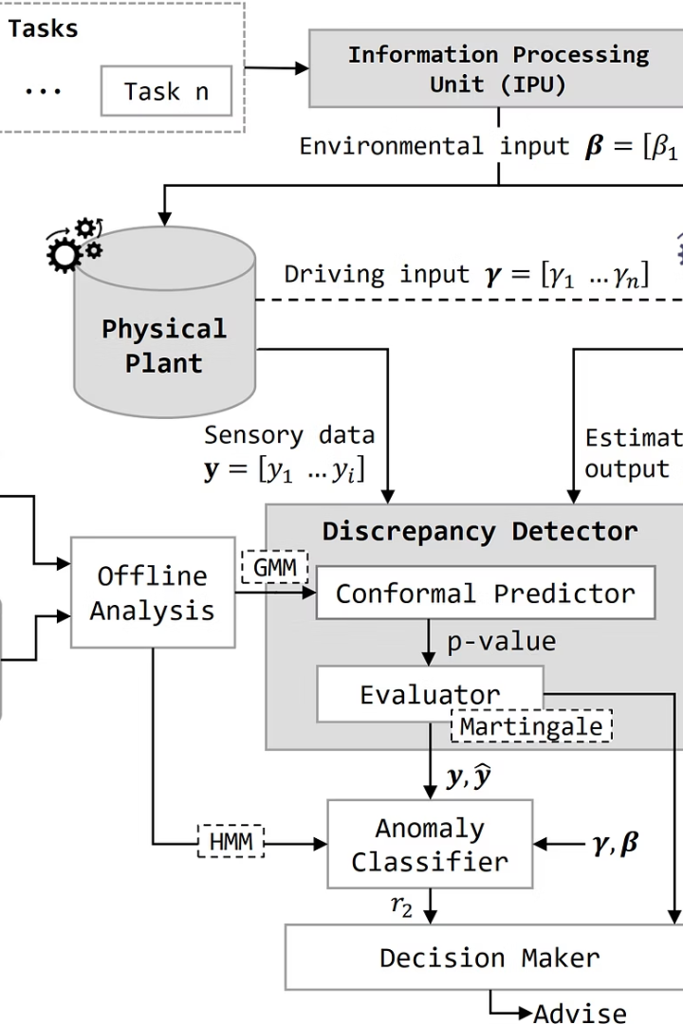
AI Techniques Enhancing CPS Security
Anomaly Detection
Predictive Maintenance
AI models monitor sensor data and network traffic to identify unusual patterns signaling faults or attacks.
Machine learning predicts system failures, reducing downtime and preventing accidents.
Adaptive Defense
Intelligent algorithms dynamically adapt security policies to emerging threat patterns, improving response speed.
import numpy as np from sklearn.ensemble import IsolationForest # Sample anomaly detection in sensor data data = np.array([[0.1], [0.2], [0.15], [1.5], [0.2], [0.1]]) clf = IsolationForest(contamination=0.1) clf.fit(data) pred = clf.predict(data) print(pred) # -1 indicates anomalies

Slide 5
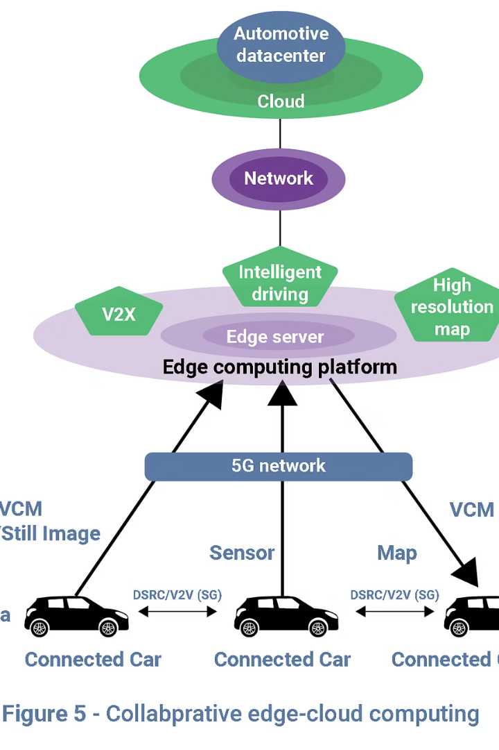
Case Study 1: AI-Powered Intrusion Detection in Autonomous Vehicles
Threats
AI Solution
Autonomous vehicles face attacks like sensor spoofing, data manipulation, and network intrusion threatening passenger safety.
Deep learning models process multisensor input to identify anomalies indicating intrusion or malfunction.
Results
The AI system successfully detects over 95% of attacks with low false positives, enhancing vehicle reliability and safety.

Slide 6
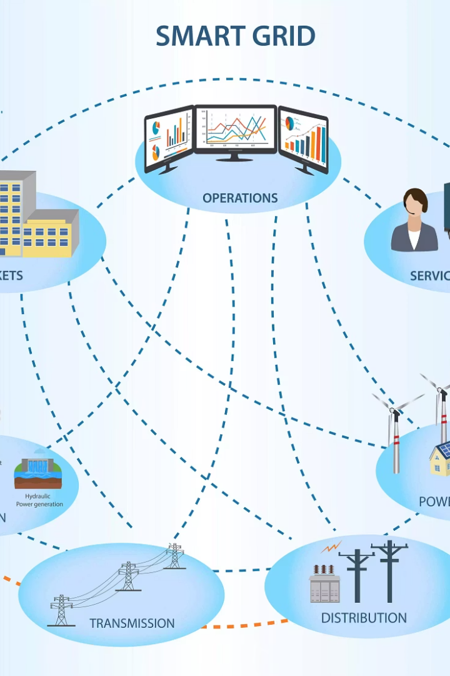
Case Study 2: Smart Grid Protection via Reinforcement Learning
Context
Reinforcement Learning Approach
Smart grids must manage power distribution efficiently while defending against cyber-physical attacks disrupting stability.
An agent learns optimal responses to network intrusions by maximizing performance metrics under uncertainty.
Sample Q-learning code snippet:
Q = np.zeros([states, actions])
for episode in range(1000):
state = env.reset()
done = False
while not done:
action = np.argmax(Q[state] + np.random.randn(1, actions)*(1./(episode+1)))
new_state, reward, done = env.step(action)
Q[state, action] = Q[state, action] + lr * (reward + y * np.max(Q[new_state]) - Q[state, action])
state = new_state

Slide 7
Challenges and Limitations of AI in Cyber-Physical Systems
AI systems in CPS can be vulnerable to adversarial attacks where malicious inputs deceive models, causing wrong decisions with serious consequences.
Moreover, real-time constraints in CPS require AI algorithms to be efficient, interpretable, and reliable under diverse operating conditions.
Data scarcity and high system complexity complicate training robust AI models tailored for critical infrastructure environments.
Addressing bias, transparency, and accountability in AI decisions remains an ongoing challenge.

Slide 8

Future Trends: Explainable AI and Federated Learning for CPS
Explainable AI (XAI)
Federated Learning
XAI techniques enable understanding and trust in AI decision-making by providing clear rationales, critical for safety-critical CPS applications.
This approach trains AI models collaboratively across decentralized CPS devices while preserving data privacy and security.
Edge AI
Deploying AI analytics at the edge reduces latency, improves responsiveness, and enhances security by processing data locally.

Slide 9
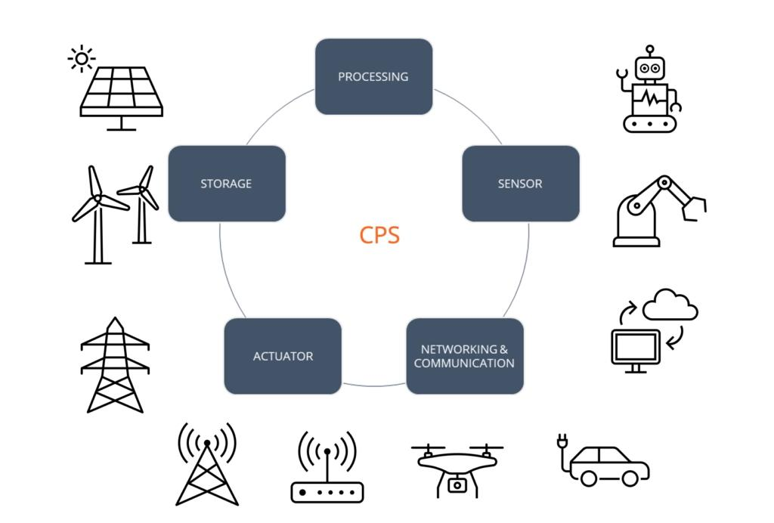

Key Takeaways and Next Steps: Securing the Future of Cyber-Physical Systems
1
Integrate AI-Based Detection
2
Address AI Limitations
Adopt anomaly detection and adaptive defense to proactively identify and mitigate threats in CPS deployments.
Focus on robustness, interpretability, and resilience to adversarial attacks when developing AI models for CPS.
3
Invest in Future Technologies
Leverage explainable AI, federated learning, and edge AI for scalable and privacy-aware CPS security solutions.

Slide 10
Real-Life Examples of AI in CPS Security
Industrial Automation
Healthcare CPS
Transportation Networks
AI enables predictive maintenance in factories by analyzing sensor data to prevent equipment failure and costly downtime.
Medical devices use AI to monitor patient conditions in real time, alerting clinicians to emergencies or anomalies.
Railway systems use AI to detect faults and optimize traffic flow, enhancing safety and efficiency on tracks.

Slide 11



Benefits, Advantages, and Disadvantages of AI in CPS
Advantages
Adaptability to evolving threats
Benefits
2
Ability to process large data volumes
Improved safety and reliability of physical systems
Continuous learning and optimization
1
Faster response to cyber threats
Disadvantages
Enhanced automation and efficiency
Vulnerability to adversarial attacks
3
Complexity and interpretability challenges
Dependence on high-quality data

